Slide 1


Forecasting NYC’s 311 Service
May 30, 2024
Presented by Rick Lataille

Slide 2
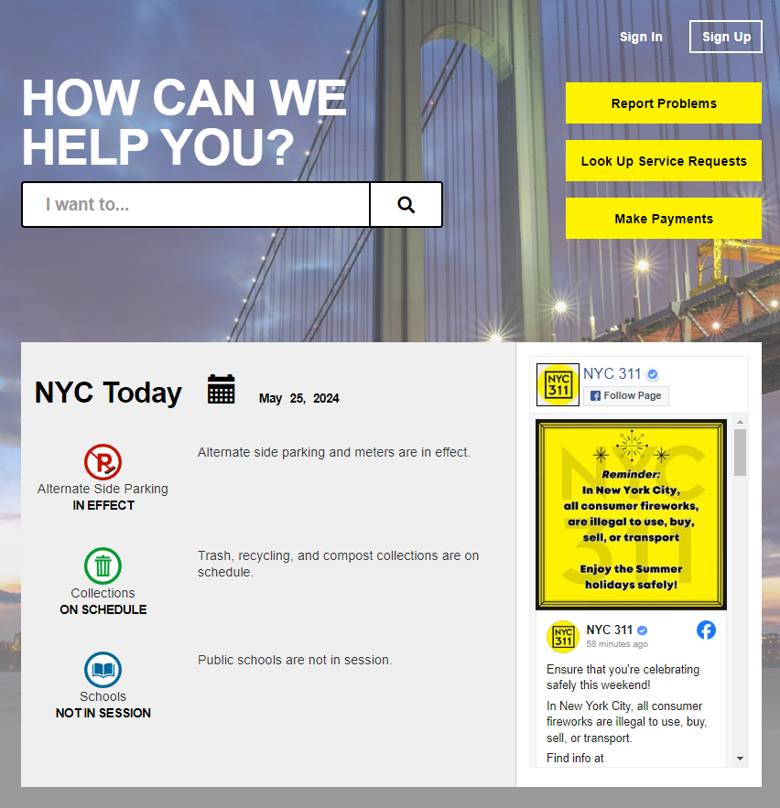
311 Connects NYC Residents to the City
Streamlines access to City
Reduces City’s costs
Improves quality of life
Improves satisfaction

Slide 3
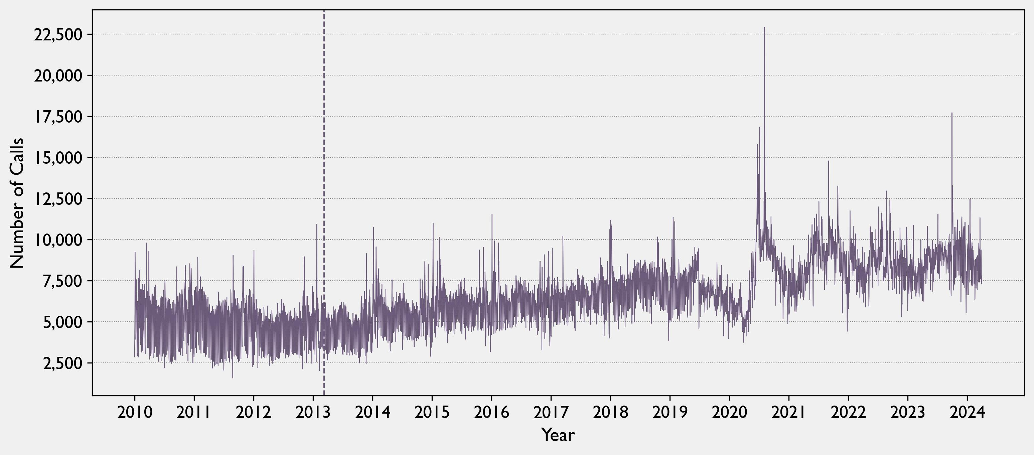
Demand is Higher and Volatile
March 9, 2013
311 App Release
August 20, 2024
Hurricane Isaiah
22,904 calls

Slide 4
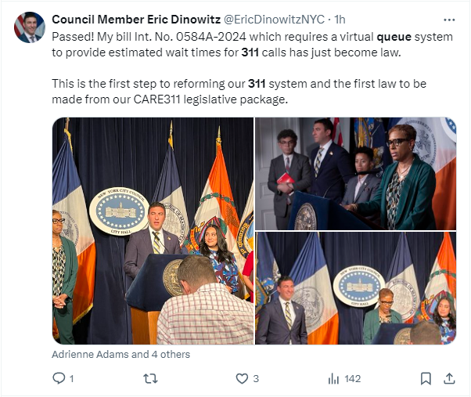
Expectations are High
Increased usage = longer wait times = Angry New Yorkers

Slide 5
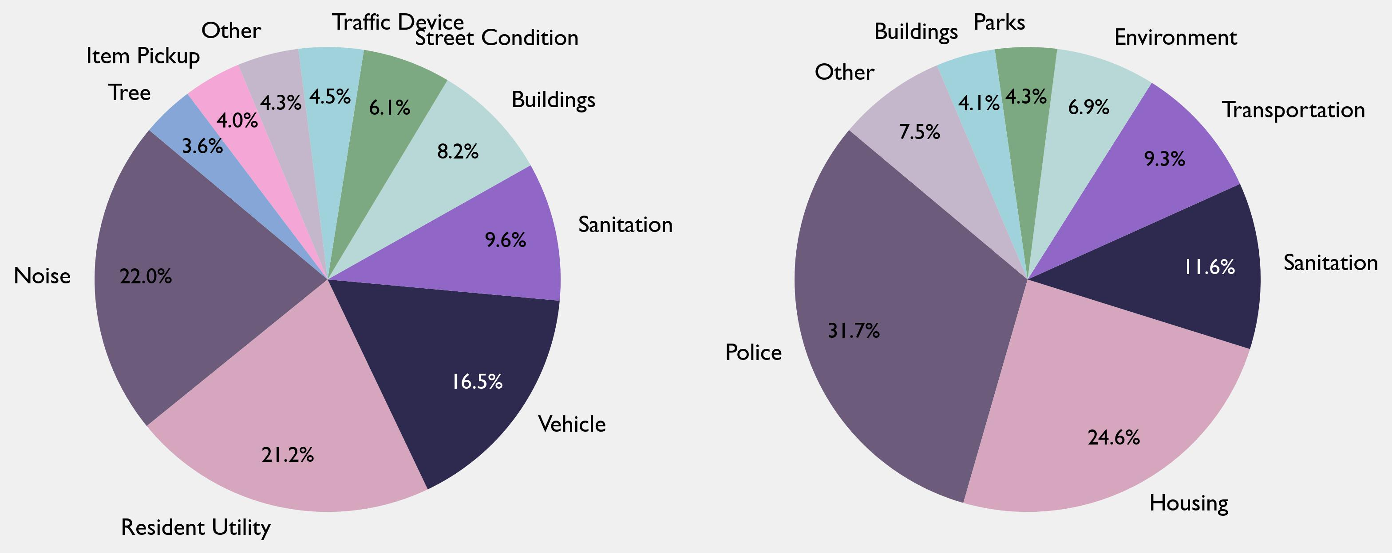
There are Many Agencies and Services…

Slide 6
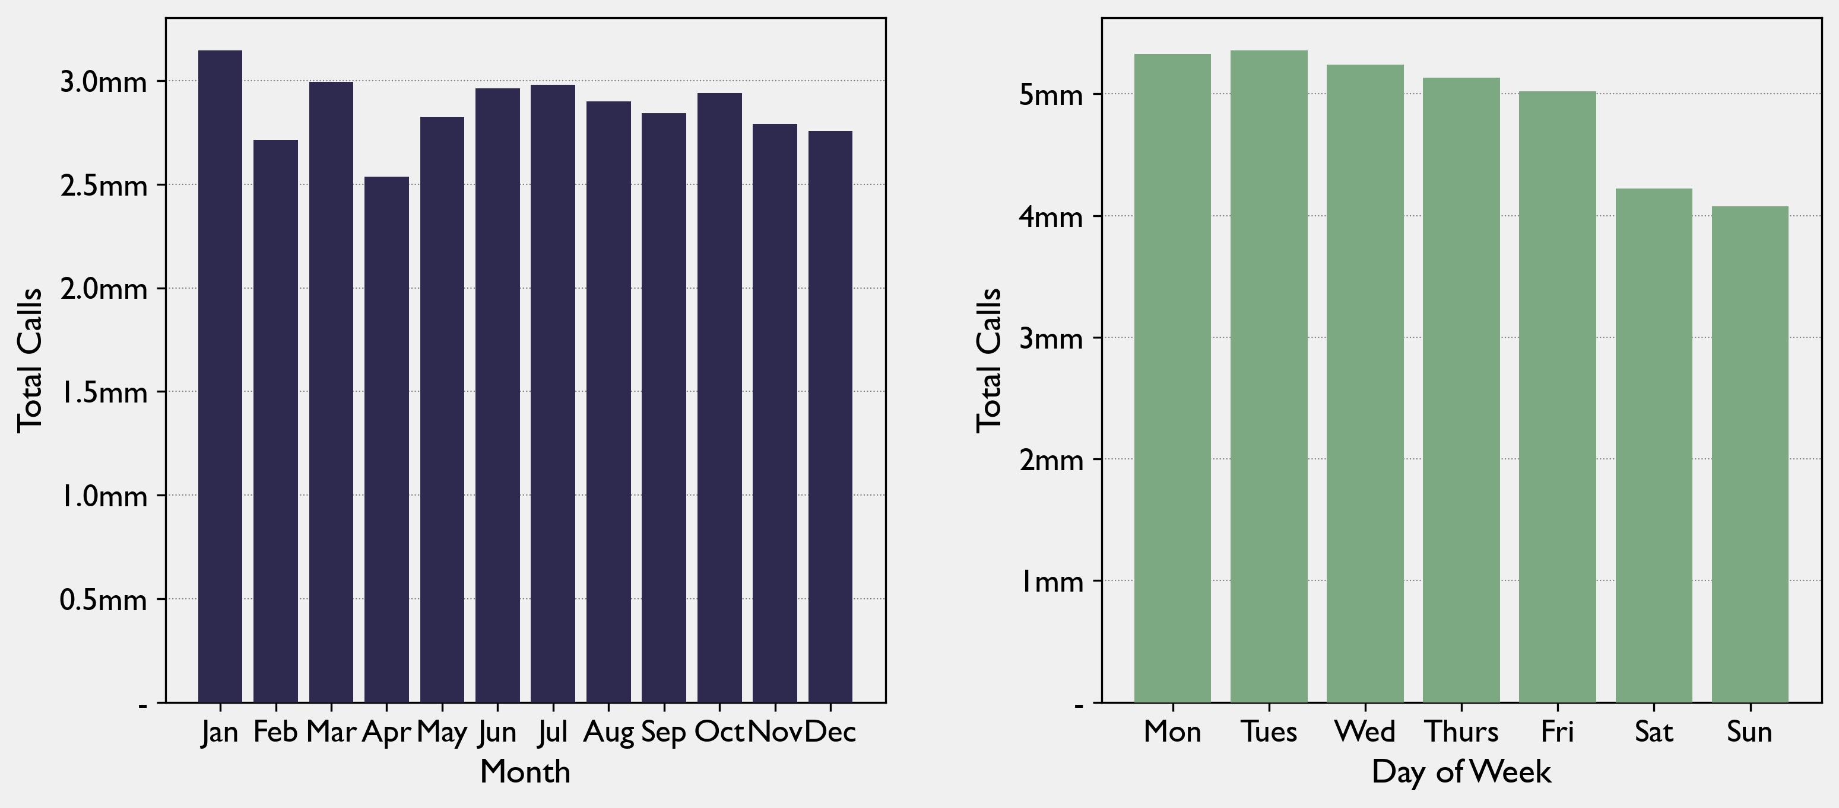
…With Limited Predictable Patterns

Slide 7
What will usage be next week
HEADING

Slide 8
What will usage be next month
HEADING

Slide 9
Further Inquiry
HEADING
Reporting bias – careful with policy

Slide 10
Further Inquiry
HEADING
Reporting bias – careful with policy
Underlying seasonality
Geographic – Type patterns

